Slide 1
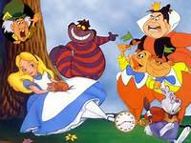
Alice in Wonderland through the technical ages

Slide 2
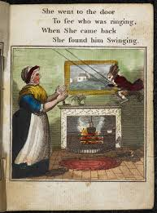
Book – written in 1865 by Lewis Carroll

Slide 3
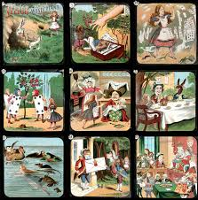
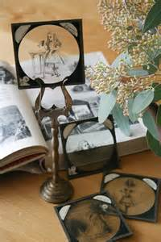
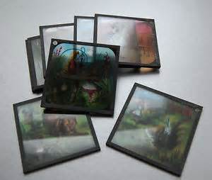
Magic Lantern – 1st showing of Lewis Carroll’s Alice in Wonderland

Slide 4
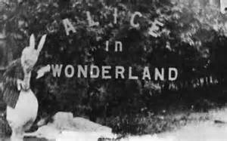
http://www.youtube.com/watch?v=zeIXfdogJbA
Alice in wonderland 1903 – Moving Picture shows

Slide 5
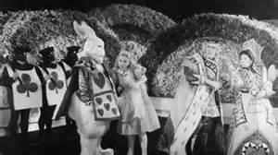
https://www.youtube.com/watch?v=gQgmpEom3KI
Alice in wonderland 1933 - Cinema

Slide 6
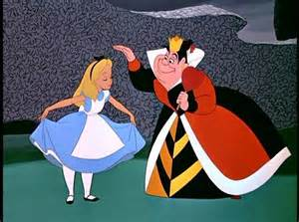
http://www.youtube.com/watch?v=KLIqErnQCuw
1951 – Walt Disney - Colour

Slide 7
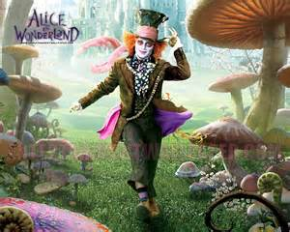
http://www.youtube.com/watch?v=8B7s01DpBTg
Tim Burton 2010

